Slide 1
Overview of c# Programming

Slide 2
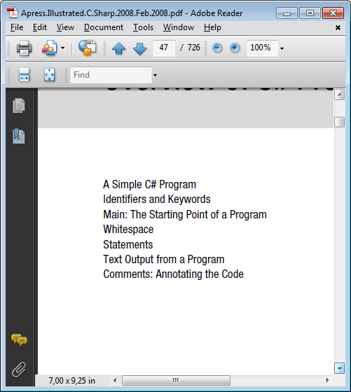
Basit bir c# programı
Belirleyiciler ve Anahtar kelimeleri
Main- Programın başladığı nokta
Boşluklar
İfadeler
Programdan text yazdırma
yorumlar

Slide 3
I first need to show you what a C# program looks like and what its various parts mean.
Let’s start by looking at a simple C# program.
The complete program source is shown At next slide. As shown, the code is contained in a text file called SimpleProgram.cs. As you read through it, don’t worry about understanding all the details.
I will give a line-by-line description of the code.
When the code is compiled and executed, it displays the string “Hi there!” in a window on the screen.
• One line contains two contiguous slash characters. These characters—and everything following them on the line—are ignored by the compiler. This is called a single-line comment.

Slide 4
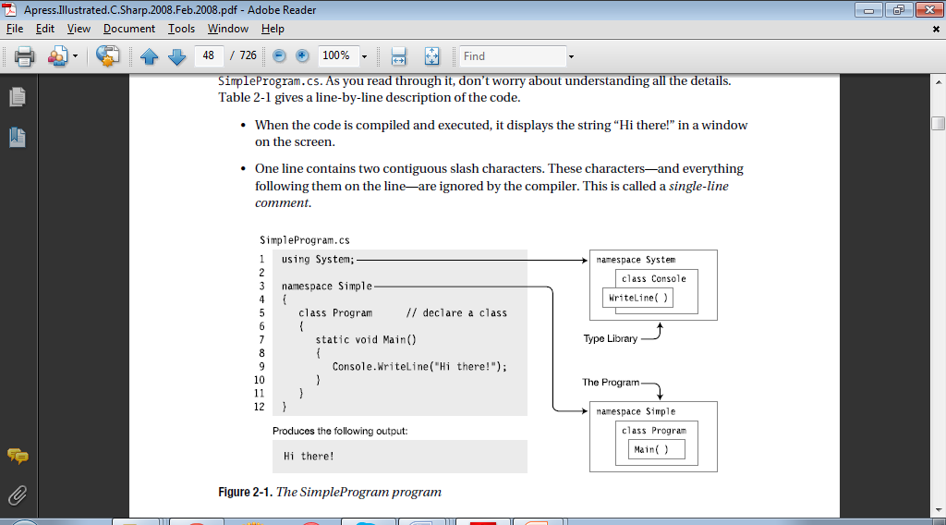

Slide 5
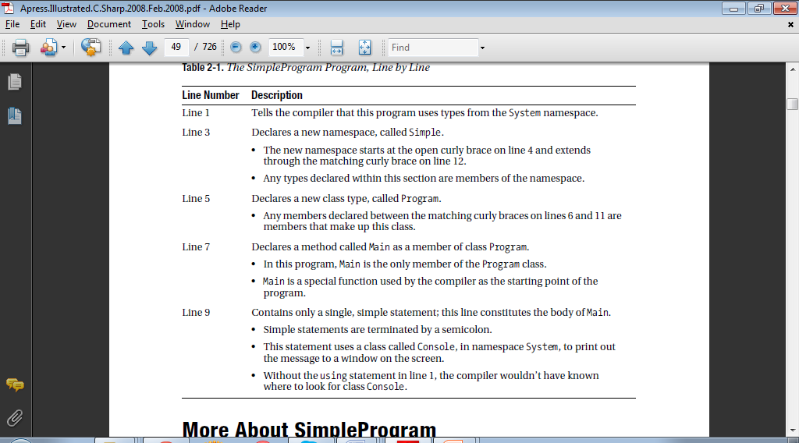

Slide 6
More About SimpleProgram
A C# program consists of one or more type declarations.
The types in a program can be declared in any order. In the SimpleProgram example, only the class type is declared.
A namespace is a set of type declarations associated with a name.
SimpleProgram uses two namespaces. It creates a new namespace called Simple, and uses a predefined namespace called System.

Slide 7
More About SimpleProgram
To compile the program, you can use Visual Studio or the command-line compiler. To use
the command-line compiler, in its simplest form, use the following command:
csc SimpleProgram.cs
In this command, csc is the name of the command-line compiler and SimpleProgram.cs is
the name of the source file.

Slide 8
Identifiers and Keywords
Identifiers are character strings used to name things such as variables, methods, parameters, and a host of other programming constructs that will be covered later.
You can create self-documenting identifiers by concatenating meaningful words into a single descriptive name, using uppercase and lowercase letters (e.g., CardDeck, PlayersHand, FirstName, SocSecurityNum). Certain characters are allowed or disallowed at certain positions in an identifier.
• The alphabetic and underscore characters (a through z, A through Z, and _) are allowed at any position.
• Digits are not allowed in the first position, but are allowed everywhere else.
• The @ character is allowed in the first position of an identifier, but not anywhere else. The use of the @ character, although allowed, is discouraged for general use.
These rules are illustrated as following

Slide 9
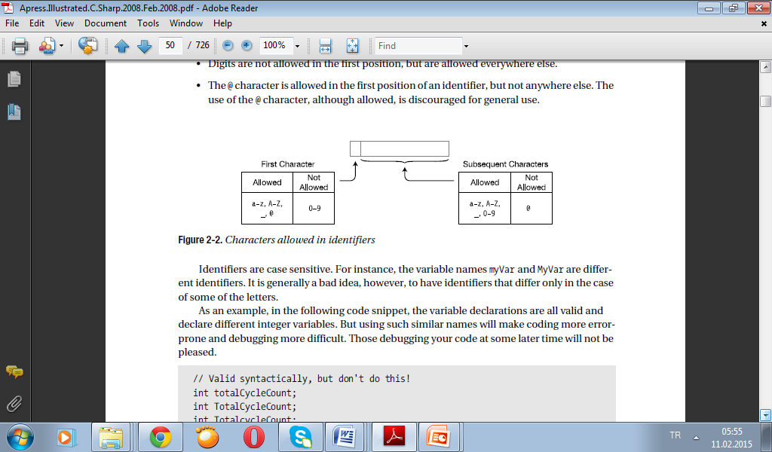
Identifiers are case sensitive. For instance, the variable names myVar and MyVar are different identifiers. It is generally a bad idea, however, to have identifiers that differ only in the case of some of the letters.
As an example, in the following code snippet, the variable declarations are all valid and declare different integer variables. But using such similar names will make coding more errorprone and debugging more difficult. Those debugging your code at some later time will not be pleased.
// Valid syntactically, but don't do this!
int totalCycleCount;
int TotalCycleCount;
int TotalcycleCount;

Slide 10
Naming Conventions
The C# Language Specification suggests that certain casing conventions be used in creating identifiers.
The suggested guidelines for casing are described and summarized in Table
For most identifiers, the Pascal casing style should be used. In this style, each of the words combined to make an identifier is capitalized
for example,
FirstName and LastName.

Slide 11
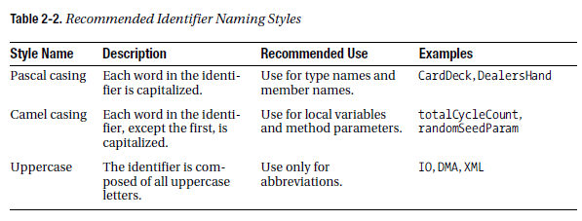
Although these are the suggested guidelines, many organizations use other conventions—particularly in the naming of member fields, which will be introduced in following weeks text.
Two of the common conventions are the following:
• Begin a field name with an underscore: _HighTemp, _LowTemp.
• Begin a field name with m_: m_HighTemp, m_LowTemp.
Both of these methods have the advantage of showing you immediately that these identifiers are field names. These forms also allow Visual Studio’s IntelliSense feature to group all the fields together in the pop-ups.

Slide 12
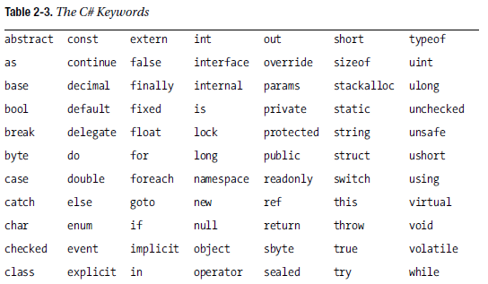
Keywords
Keywords are the character string tokens used to define the C# language. A complete list of the C# keywords is given in Table.
Some important things to know about keywords are the following:
• Keywords cannot be used as variable names or any other form of identifier, unless prefaced with the @ character.
• All C# keywords consist entirely of lowercase letters. .NET type names, however, use Pascal casing.

Slide 13
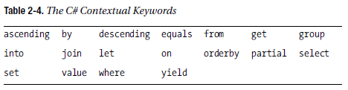
Contextual keywords are identifiers that act as keywords only in certain language constructs.
In those positions, they have particular meanings; but unlike keywords, which cannot ever be used as identifiers, contextual keywords can be used as identifiers in other parts of the code.
The list of contextual keywords is shown in Table .

Slide 14
Main: The Starting Point of a Program
Every C# program must have one class with a method (function) called Main. In the SimpleProgram program shown previously, it was declared in a class called Program.
• The starting point of execution of every C# program is at the first instruction in Main.
• The name Main must be capitalized.
• The simplest form of Main is the following:
static void Main( )
{
Statements
}

Slide 15
Whitespace
Whitespace in a program refers to characters that do not have a visible output character.
Whitespace in source code is ignored by the compiler, but is used by the programmer to make the code clearer and easier to read. Some of the whitespace characters include the following:
• Space
• Tab
• New line
• Carriage return
For example, the following code fragments are treated exactly the same by the compiler in spite of their differences in appearance.
// Nicely formatted
Main()
{
Console.WriteLine("Hi, there!");
}
// Just concatenated
Main(){Console.WriteLine("Hi, there!");}

Slide 16
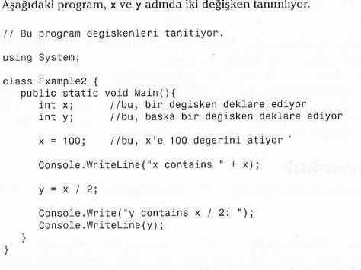

Slide 17
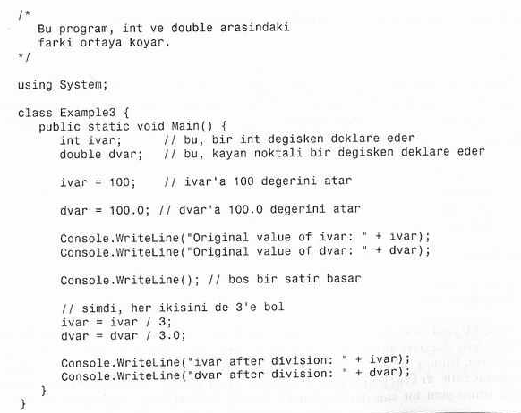


Slide 18
